Slide 1
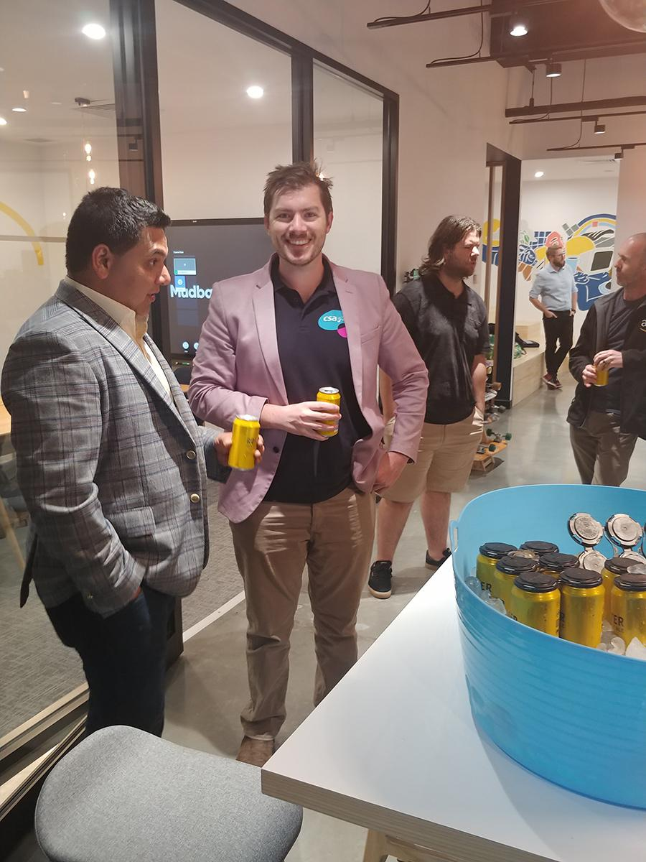


About ME:
DANE STEVENSON – CLOUD ARCHITECT @ CSA
AWS Certified – 2015
Lead cloud arch @ uOn ( although I work with matt, so really just a peon)
PRODUCT OWNER && PLATFORM ARCH OF CLOUD MANAGED SERVICES WITH BRENDON CONNORS
Currently studying azure arch professional
DMFSTEVENSON
/DANE STEVENSON

Slide 2
Topics of my ted talk
Patching
Monitoring
Logging
Backups
HA/DR - Automation
Questions

Slide 3
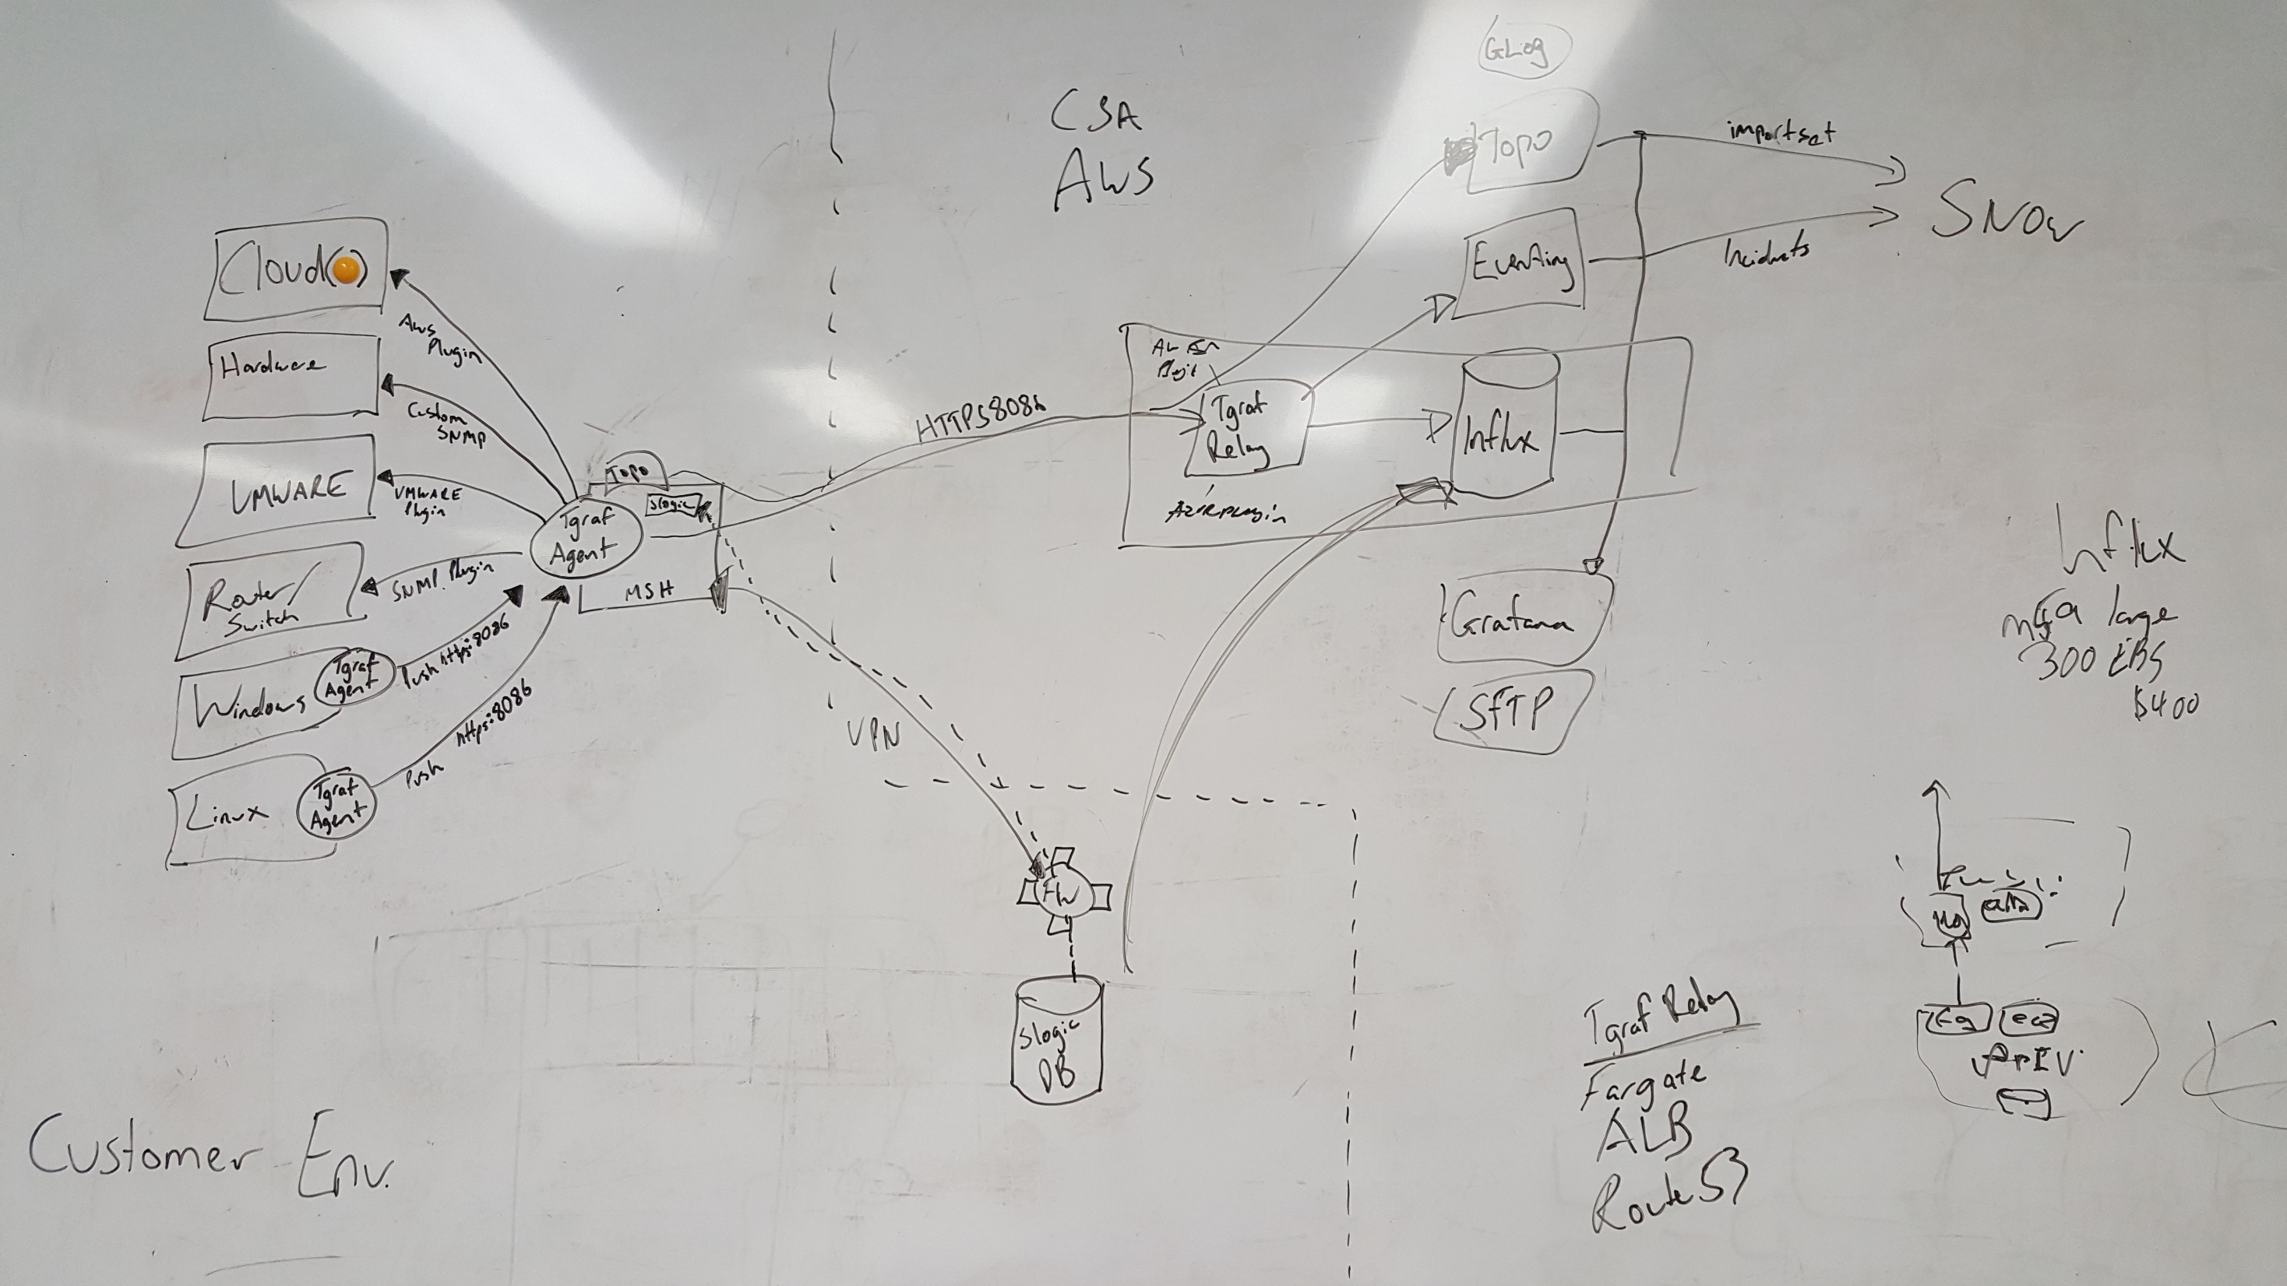
Like all good movies, we started by drawing out our plan on the whiteboard

Slide 4
patching
Current patch scenario
- CSA rundeck instance scans Maintenance schedules defined in SNOW
- If patching is scheduled to occur within the next 3 weeks a SNOW request is raised
- SD Agent coordinates time for patching and assigns resource
- Engineer patches server
Challenges
- Inefficient
- waste of SD time resourcing and scheduling
- waste of L2+ engineers time
- Inconsistent
- people will always do different things
- is there a process for patching that specific server?
- False alerts
- has a device been put in maintenance mode (alerts and noise)
- further waste of resources

Slide 5
patching
Proposed patch scenario
- All servers (AWS, Azure(yeah we did it), On-prem) have SSM agent installed
- All servers are tagged appropriately for patching (eg, Tag MaintenanceWindow:ProdWindows01)
- Patching is scheduled using AWS SSM Maintenance windows
- Suitable Automation documents are aligned with the maintenance windows
NOTE: Including a default catch all maintenance schedule
- Tested working as of September 21st!!!

Slide 6
Patching cont…
As a result AWS provides
- Efficiency - it’s all automated
- Consistency - the process is defined in an automation document
- Auditing - Maintenance windows and documents writing to S3
- Compliance / Visibility
- measured against defined patch baselines
NOTE: multiple customers, multiple environments, different patching requirements
- Visibility
- hooks into AWS config providing a single view of all compliance issues
- exception reporting

Slide 7
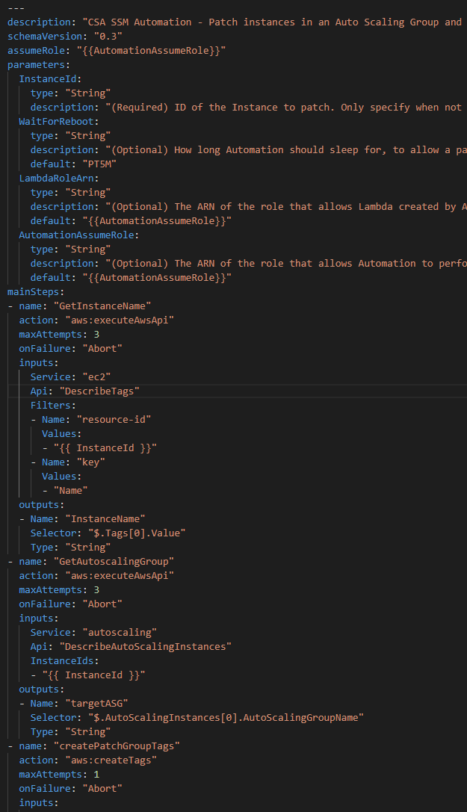
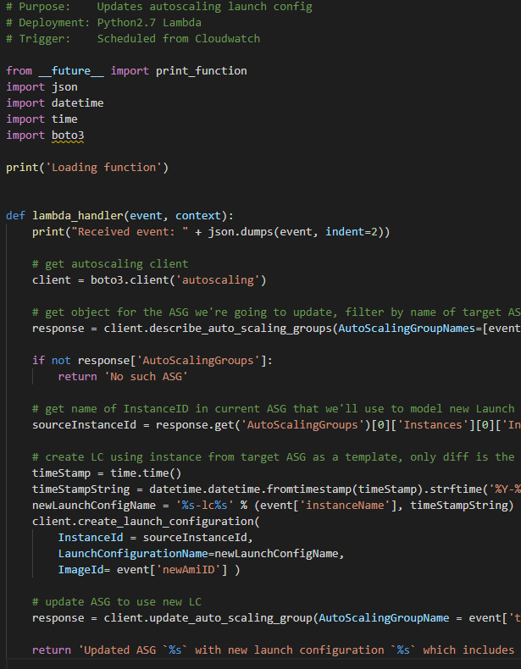

Slide 8
Monitoring / challenges
Monitoring:
- We are using a 2-step process currently to tie into ScienceLogic and ServiceNow - Current in place solution ScienceLogic for Monitoring – Poll Based - Current in place solution ServiceNow for ITSM
Current Layout:
Proposed steps to integrate and replace – Build > Buy - Define new Collector – Telegraf – agent install - Influxdb – Time-series database for future proof and growth - Topology && Eventing for integration into SNOW - Grafana and Prometheus for Monitory and Analytics visualisation - terraform12 for orchestration
Code choices: - played to our strengths internally - python, YAML, HCL2 (picked this over tf .11 for future ease)

Slide 9
logging
Splunk for big ticket customers
Graylog in pilot testing for shipping Logs, as telegraf is already shipping metrics, we can add another relay to collect logs
80/20 rule currently is polling CloudWatch logs and actioning via SNOW
Shipping logs to additional accounts with read only access
Storing logs in Glacier for regulatory compliance and governance

Slide 10
backups
AWSBACKUPS:
- We are using a Vault per Resource that we are backing up e.g. (RDSVault) - Adding a backup tag to each resource, Backup:Yes - Backups currently run every week
- Cold Storage transition after 30 days
NOTE: Even tho AWS states backups migrate to s3 -> Glacier, only EFS is able to do this.
SNAPSHOTS:
- Daily snapshots for services that allow it via snapshot policies
- RDS Daily for 35 days
- EC2 Daily for 30 days
CONFIG:
- A set of policies to alert us on failed snapshots / backups and raise a ticket in SNOW for the SD team to action

Slide 11
HA/DR & automation
Auto-scaling (HA / DR ):
- Identifying which apps can be decoupled as best as possible when migrating to the cloud
- Stripping out DB into RDS
- Packerising Code to Pull in Data from s3 as an example
- Defining ScaleOut and ScaleIn rules for each application and monitoring those events to help right size and right cost each app
NOTE: It’s hard to go into deep detail here, so keeping it rather high level
Automation
- Everything mentioned so far is fully automated at most points of the pipeline
- We want to fully utilise CI/CD going forward and have mapped this out
- A few trials in GitHub Actions / Jenkin pipeline and rundeck

Slide 12
questions
Questions?

